Slide 1
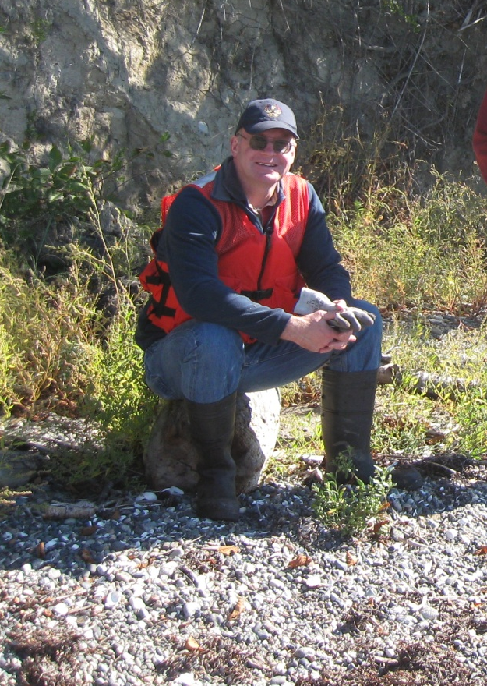

The Professional Accomplishments of
Jeremy R. Freimund, P.H.
A Partial Account from His Tenure with the
Lummi Natural Resources Department (1996-2017)

Slide 2
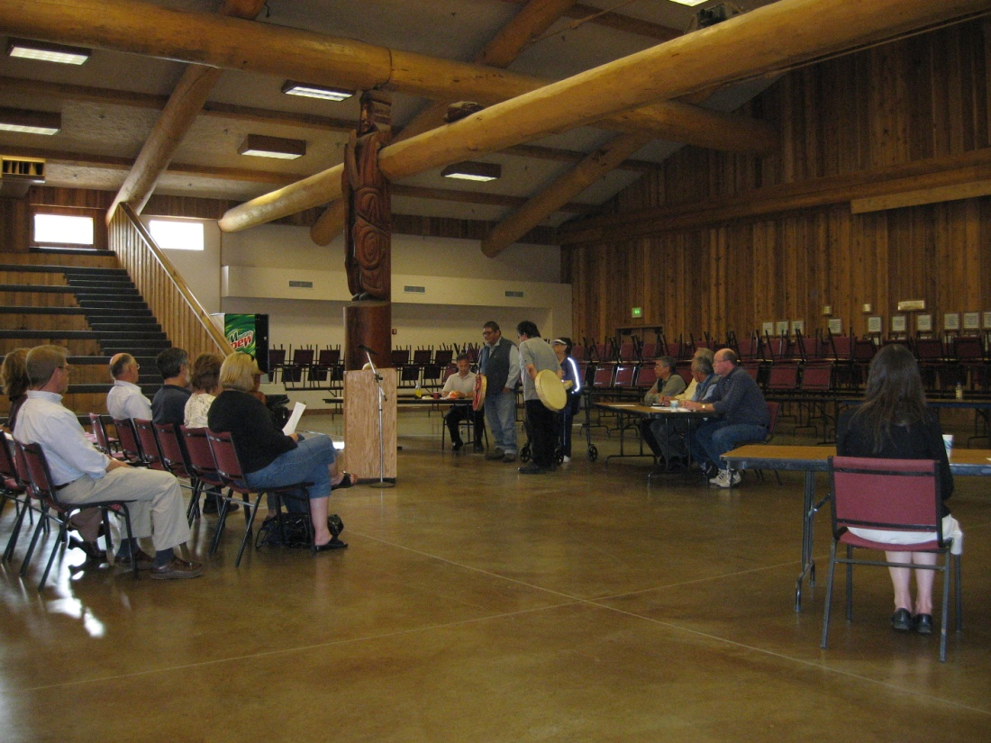
Jeremy led the development and implementation of the Lummi Nation’s Comprehensive Water Resources Monitoring Program, which includes wellhead protection, storm water management, wetland management, water quality standards, and nonpoint source pollution management.
Water Quality Standards Public Hearing (2007)

Slide 3
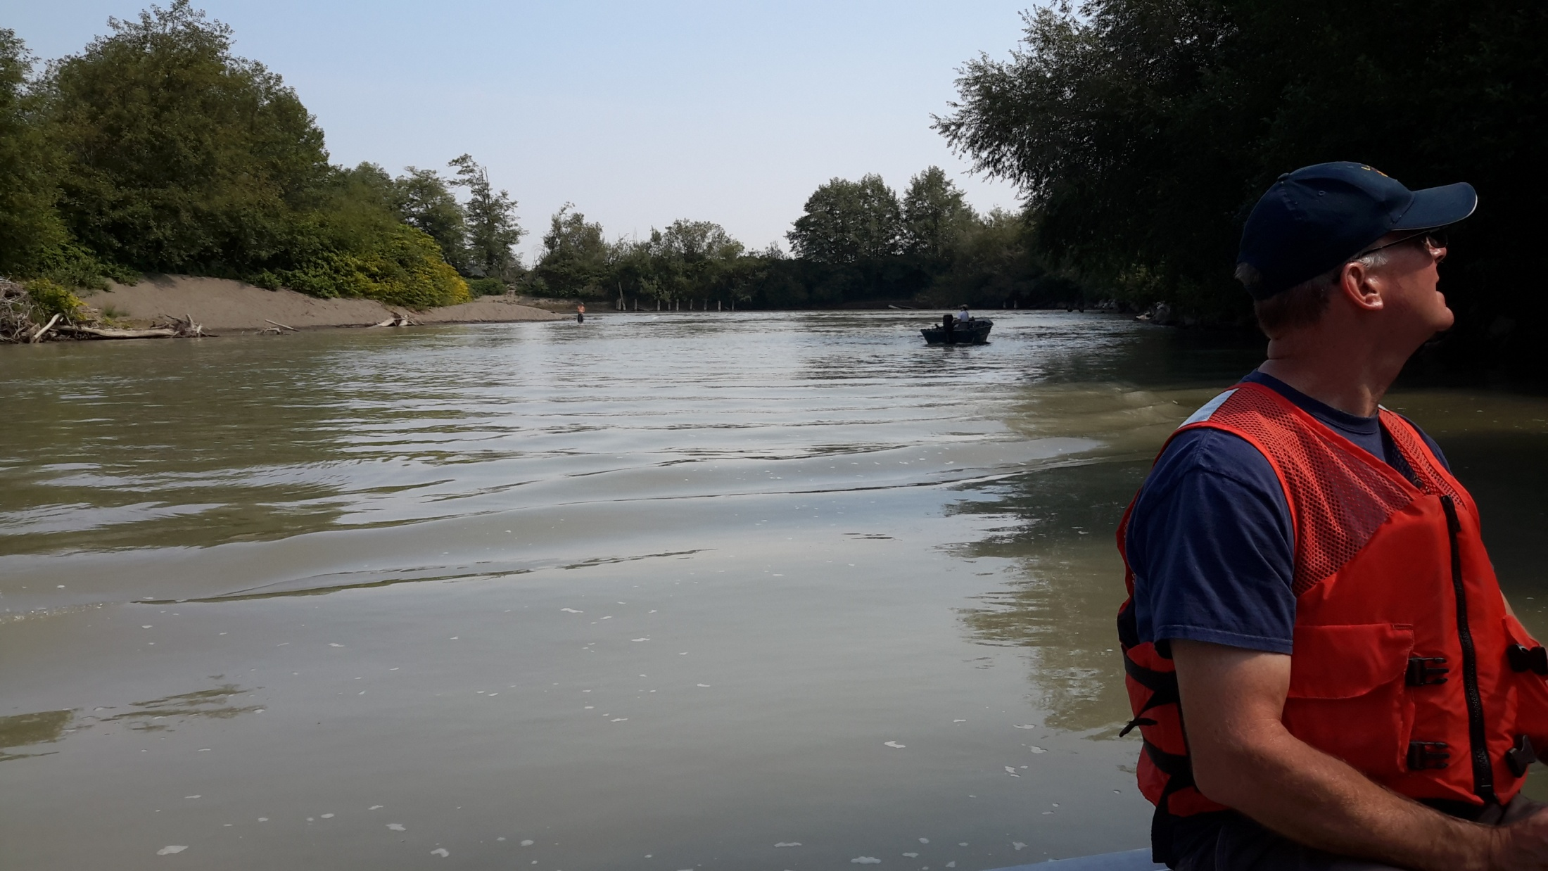
He was one of the lead technical support staff for the Water Resources Management Area 1 Watershed Management Project.
Nooksack River Survey (2016)

Slide 4
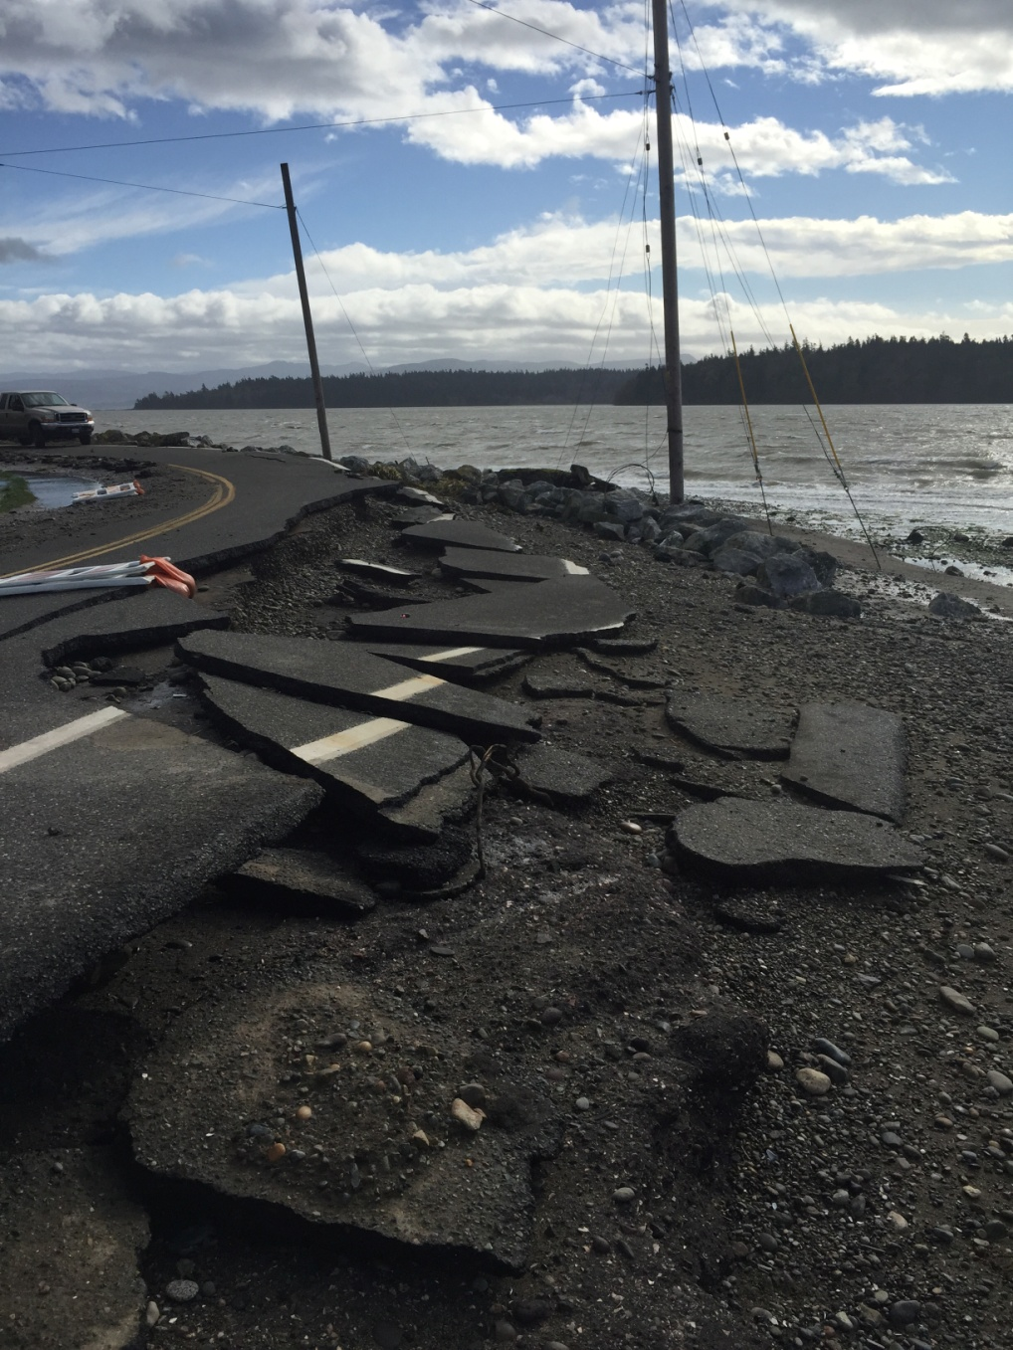
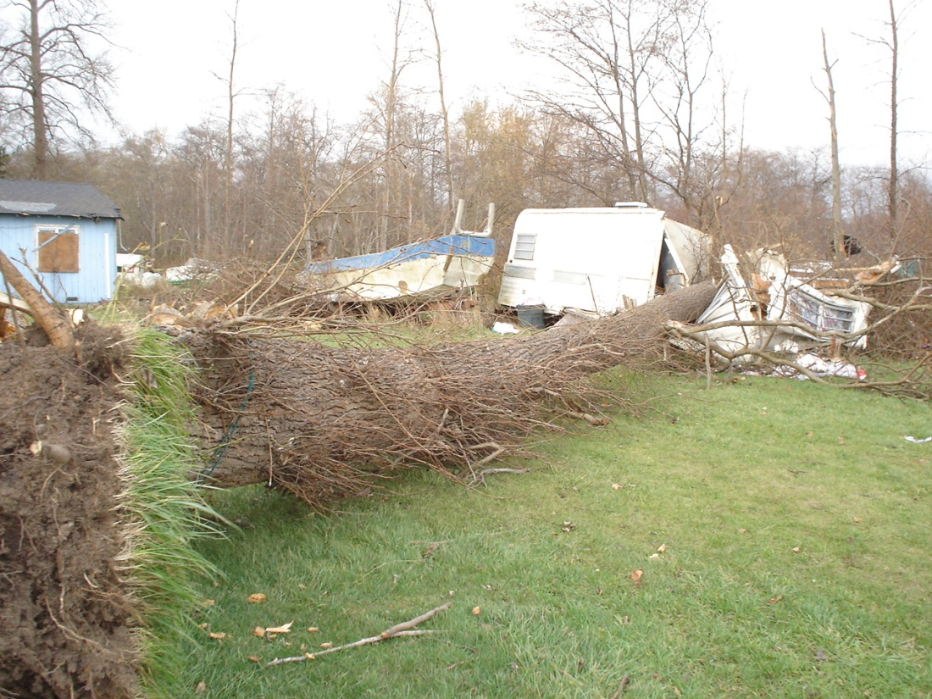
He oversaw the development and implementation of the Lummi Nation Multi-Hazard Mitigation Plan – the first such plan to be approved by the Federal Emergency Management Agency (FEMA) nationally.
Windstorm (2006)
Coastal Erosion (2015)

Slide 5
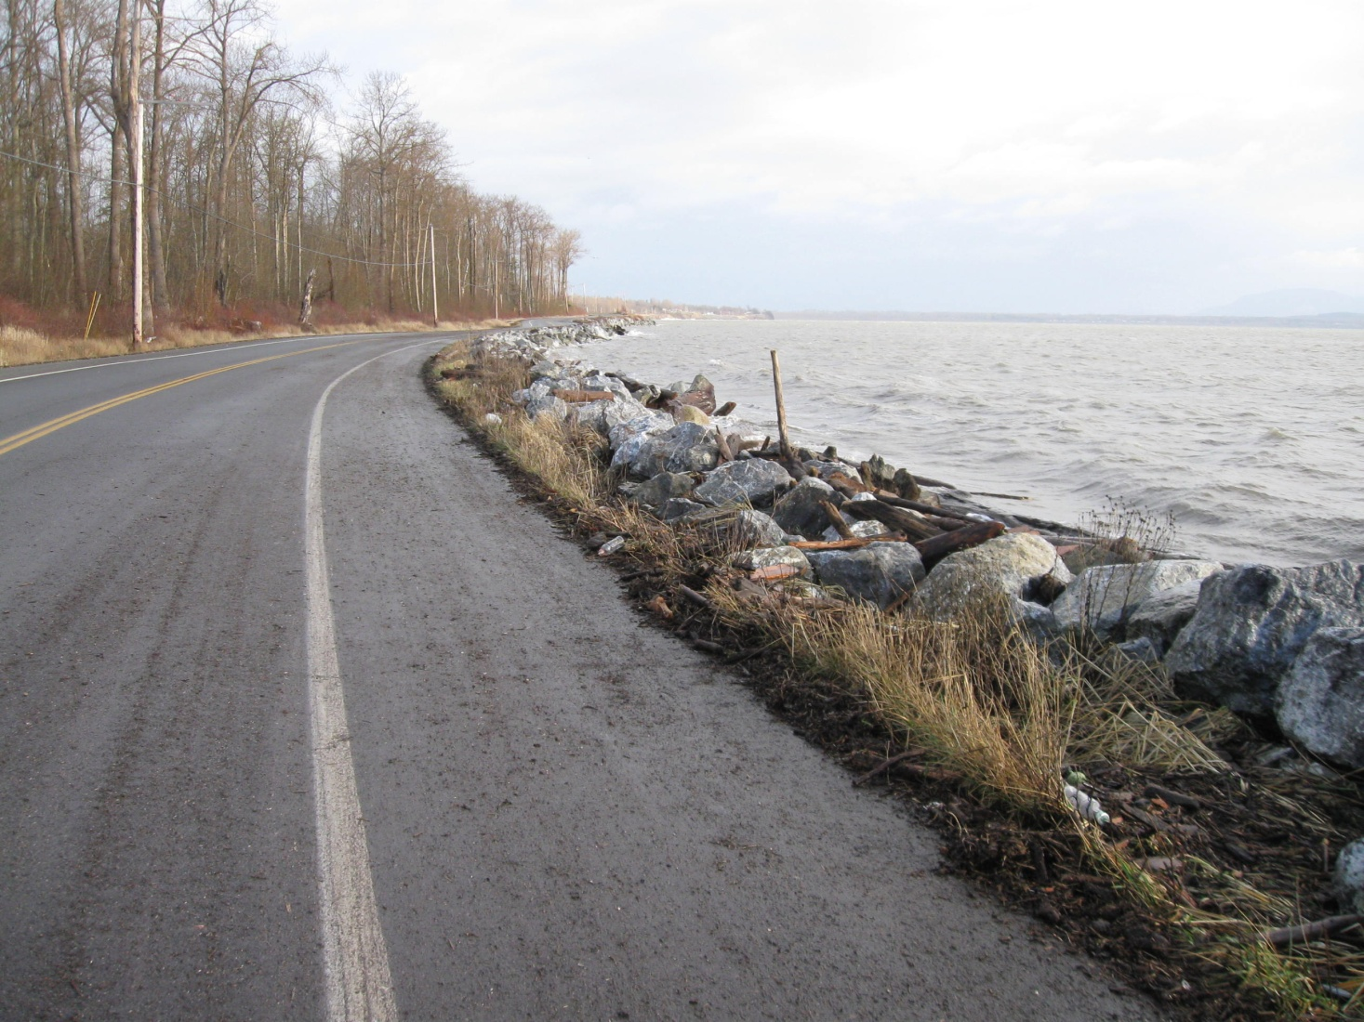
He was one of the lead technical staff for the U.S. Army Corps of Engineers revetment project to rebuild Lummi Shore Road and prevent future road damage by bluff erosion.
Lummi Shore Road Revetment (2010)

Slide 6
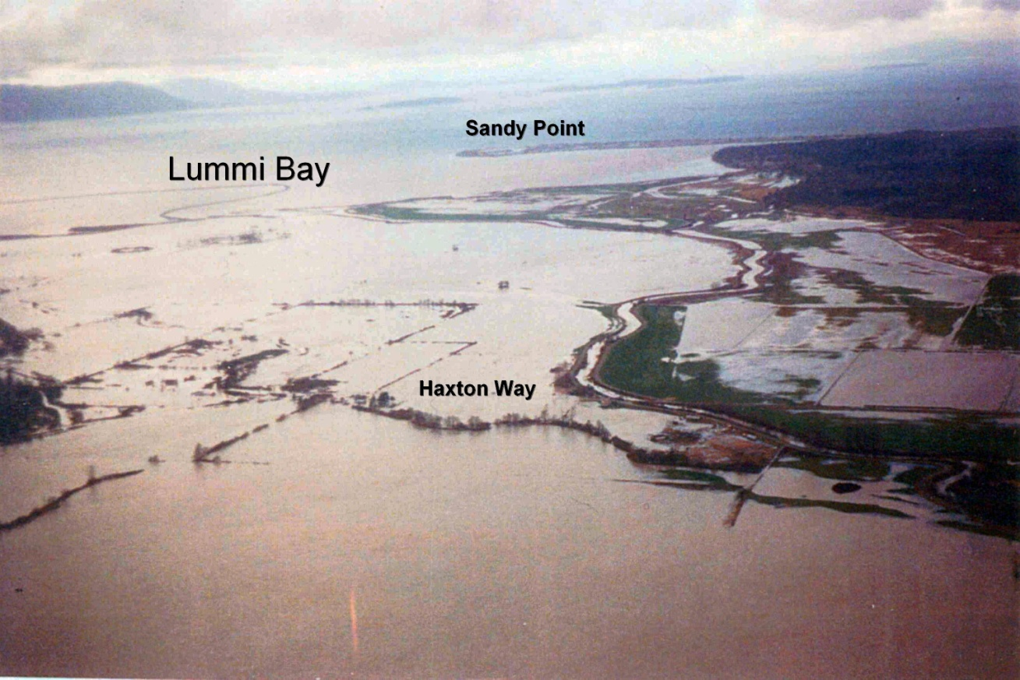
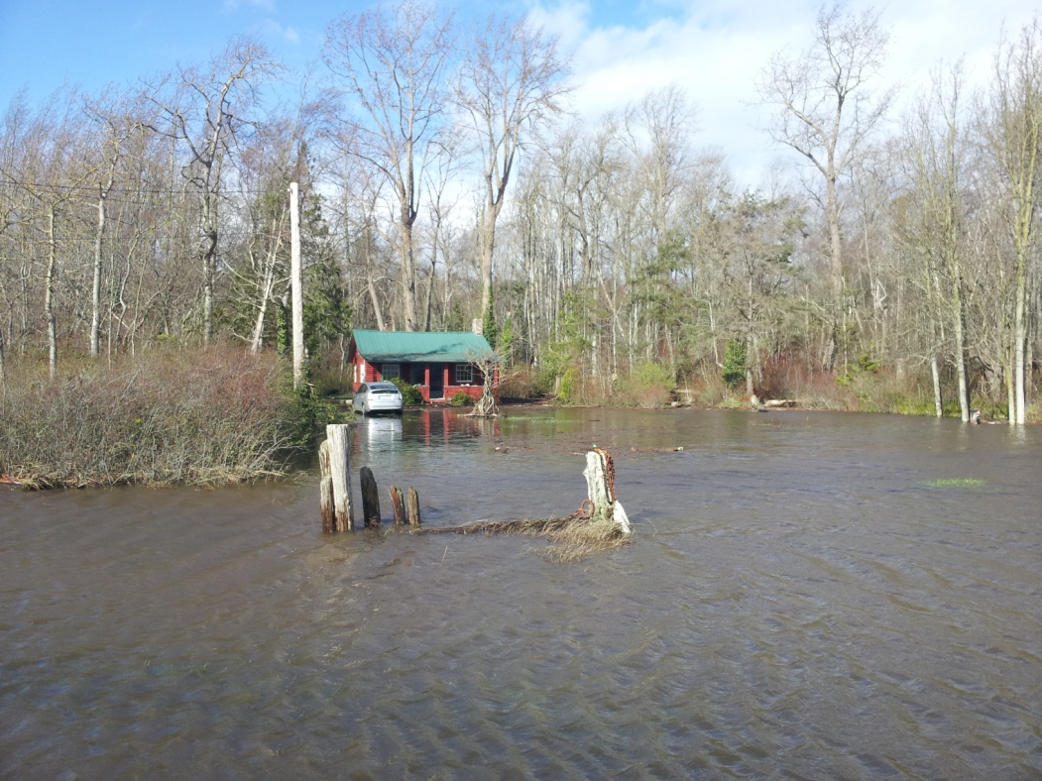
He entered the Lummi Nation as a community in good standing with the National Flood Insurance Program (NFIP) and oversaw the Lummi Nation’s application to the NFIP Community Rating System – making flood insurance available at discounted rates to Reservation residents.
Coastal Flooding (2016)
Nooksack River Flooding (1990)

Slide 7
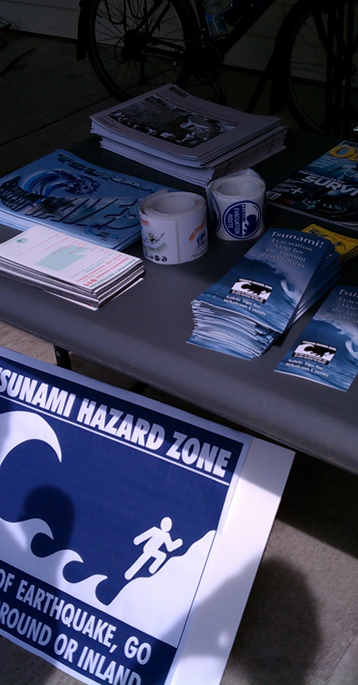
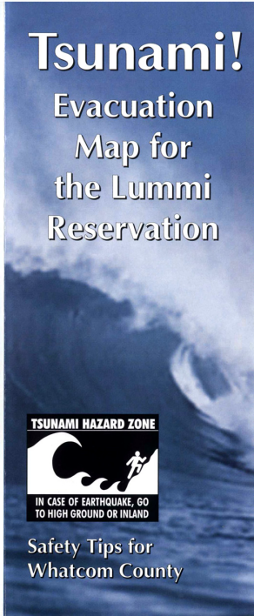
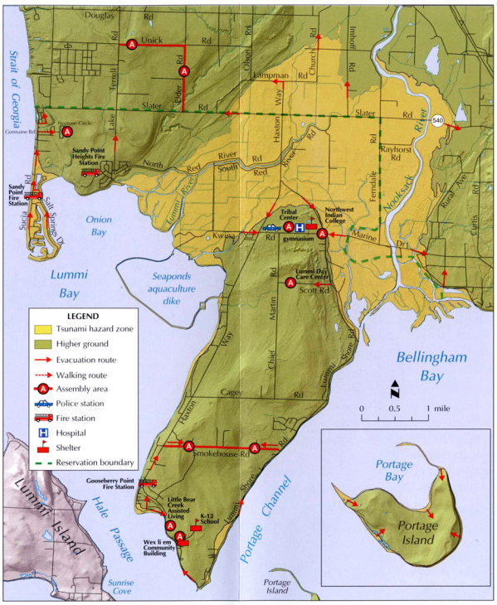
He oversaw the application and administration of a grant to install a tsunami warning system on the Lummi Indian Reservation and the development of tsunami evacuation routes.
Tsunami Evacuation Brochure (2007)
Safe Streets Walk (2013)

Slide 8
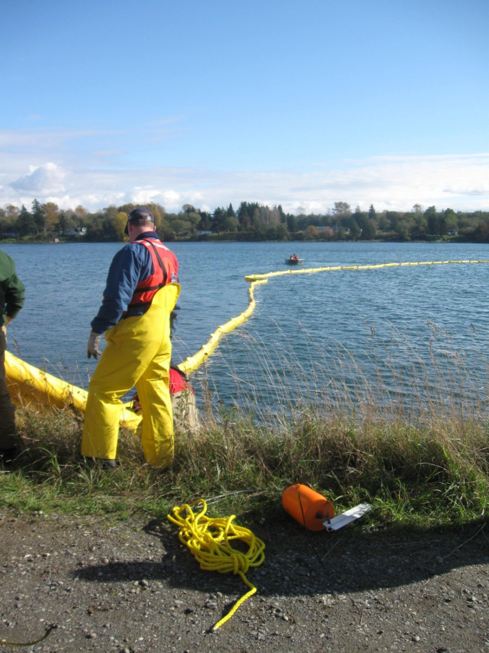
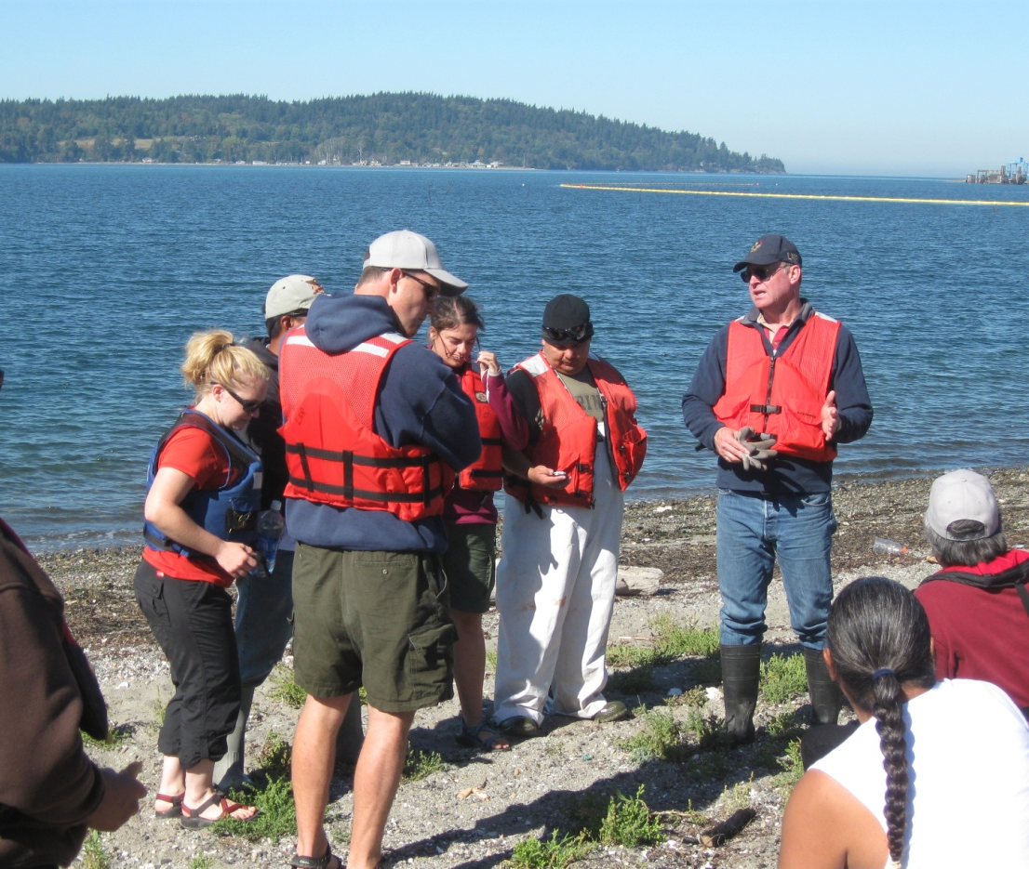
He developed oil spill response capabilities for the Lummi Nation – we now have a Spill Response Team on standby who have the training and equipment necessary to help protect sensitive environmental and cultural resources in the event of an oil spill on or near the Reservation.
Spill Drills (2010 [left], 2009 [right])

Slide 9

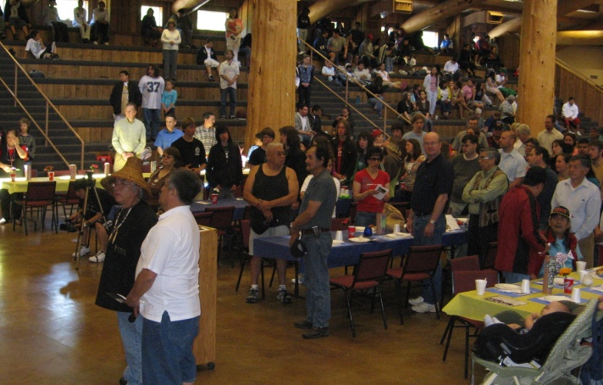
He oversaw the development of the Lummi Seafood Consumption Study to inform the development of water quality standards, which are intended to ensure that water quality criteria are protective of the public health of Lummi tribal members.
First Salmon Ceremony (2008)

Slide 10
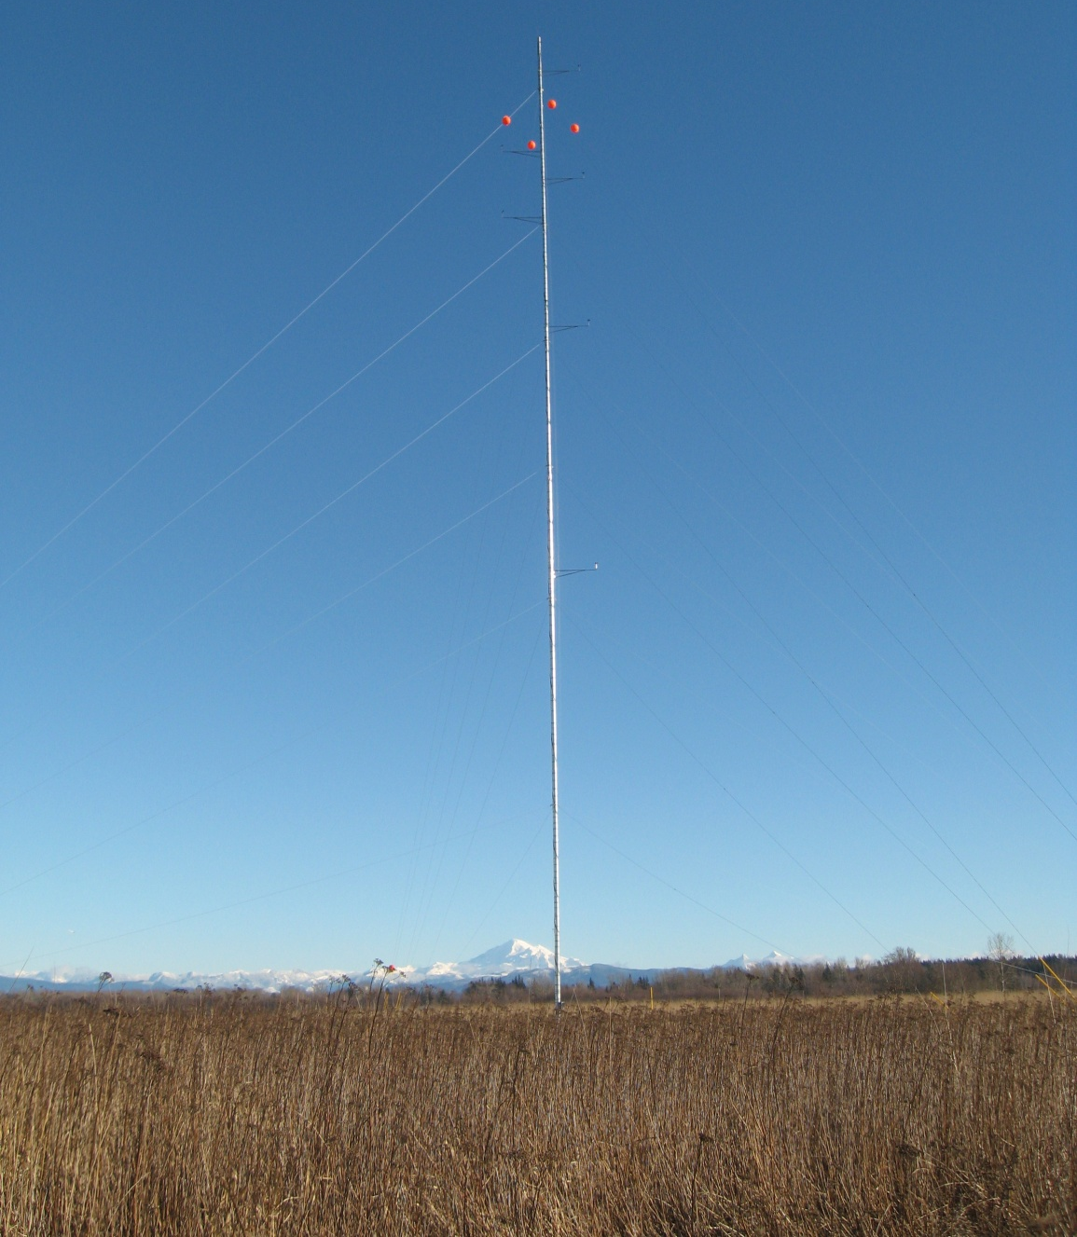
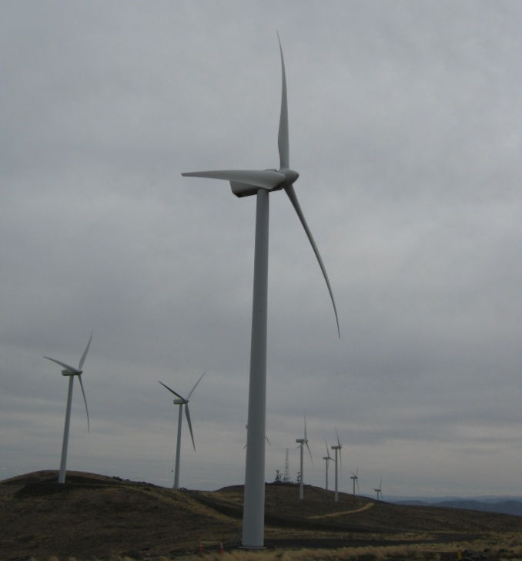
He obtained a grant from the U.S. Department of Energy and oversaw the Lummi Indian Reservation Wind Energy Feasibility Assessment Project to determine if and at what cost wind energy development on the Reservation could help achieve the tribal goal of energy self-sufficiency.
Wind Farm Tour (2011)
He also oversaw the development of the Lummi Nation Strategic Energy Plan and the Lummi Nation Climate Change Mitigation and Adaptation Plan.
Anemometer Tower (2010)

Slide 11
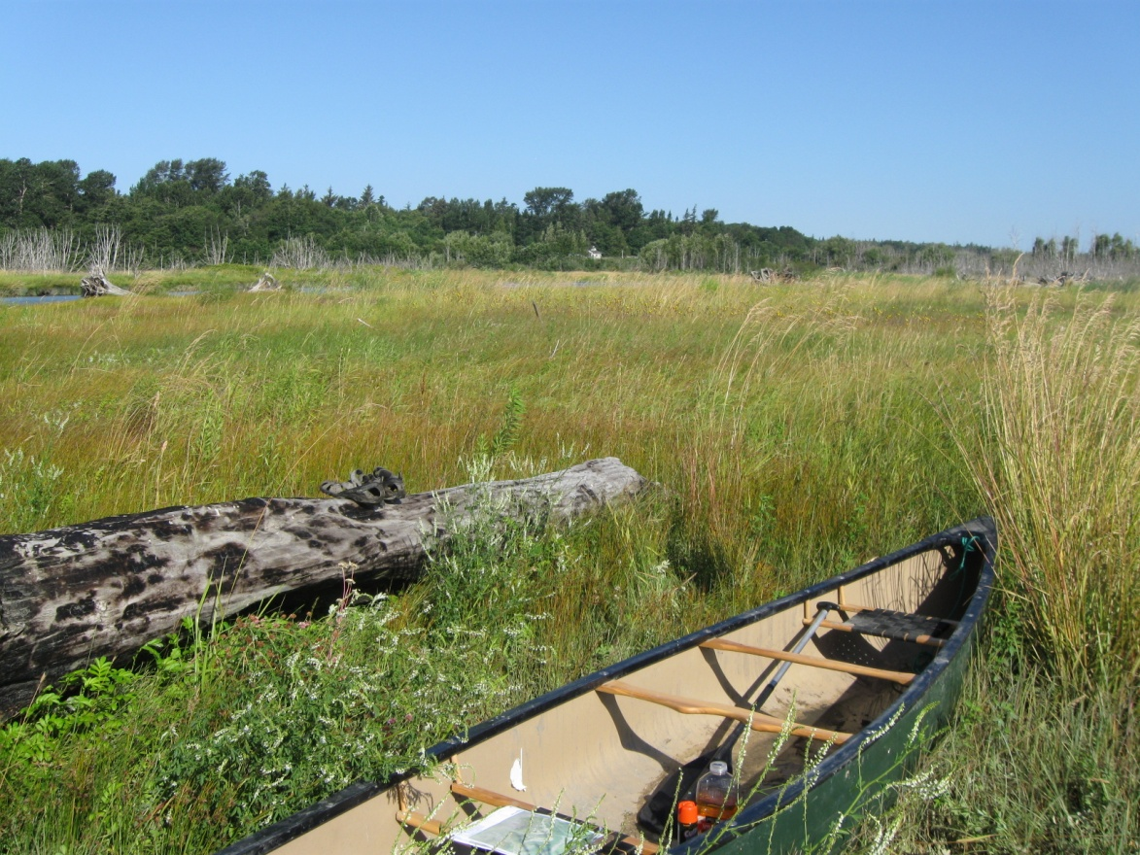
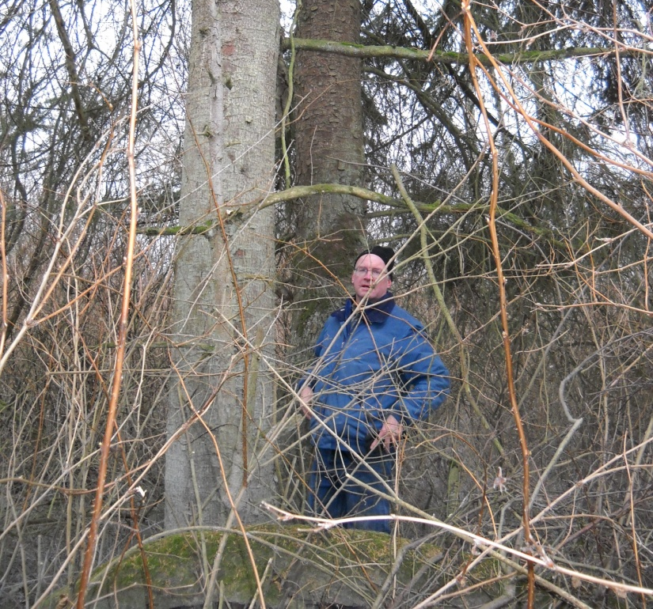
He oversaw the development and implementation of the Lummi Nation Wetland and Habitat Bank – the first tribally-owned and operated commercial wetland mitigation bank in the United States.
Nooksack Delta Site (2009)
Map of the Mitigation Bank Sites

Slide 12
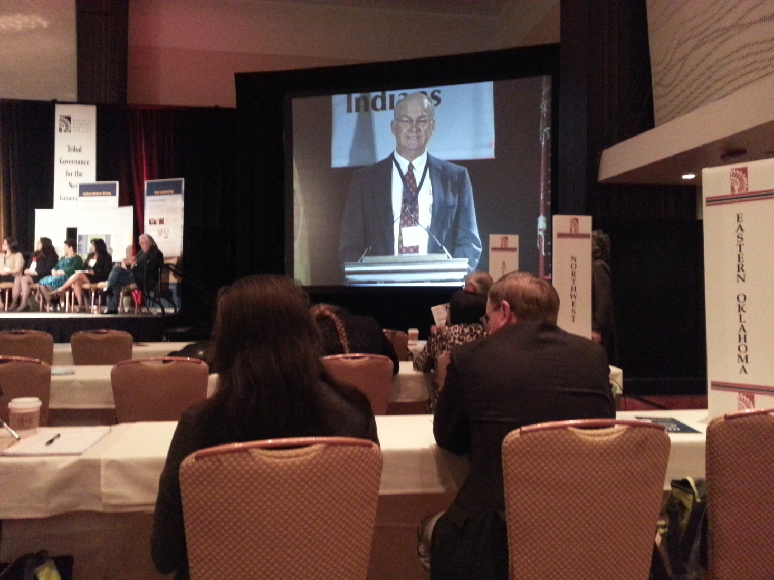
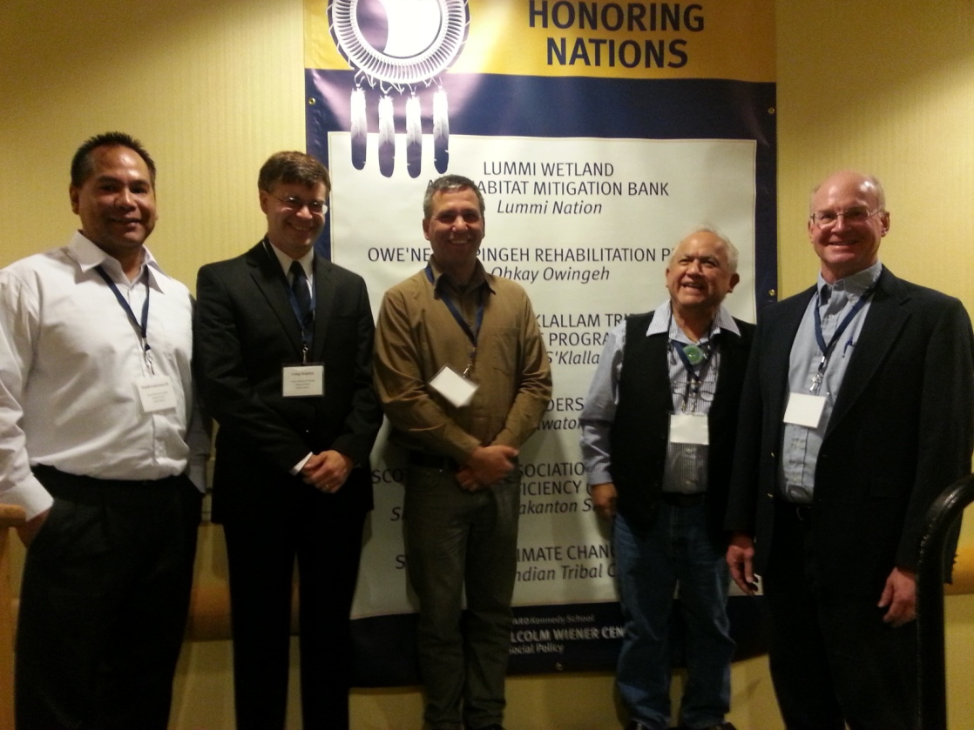
The mitigation bank was recognized by The Harvard Project on American Indian Economic Development as a finalist for its Honoring Nations award because of the project’s impact in showing that self-governance plays a crucial role in building and sustaining strong, healthy Indian Nations.
National Congress of American Indians (2014)

Slide 13
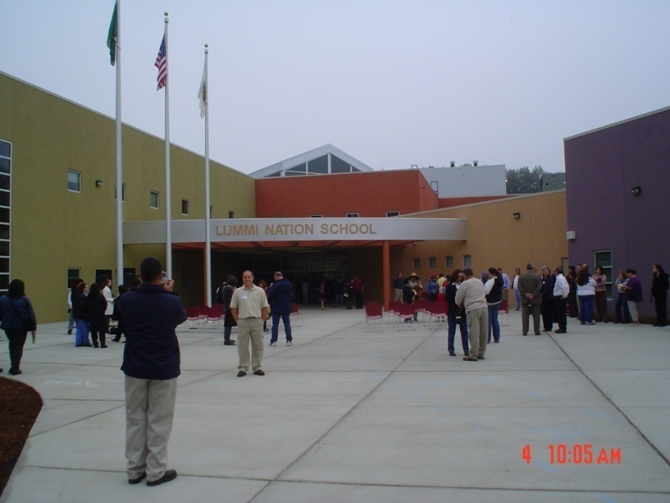
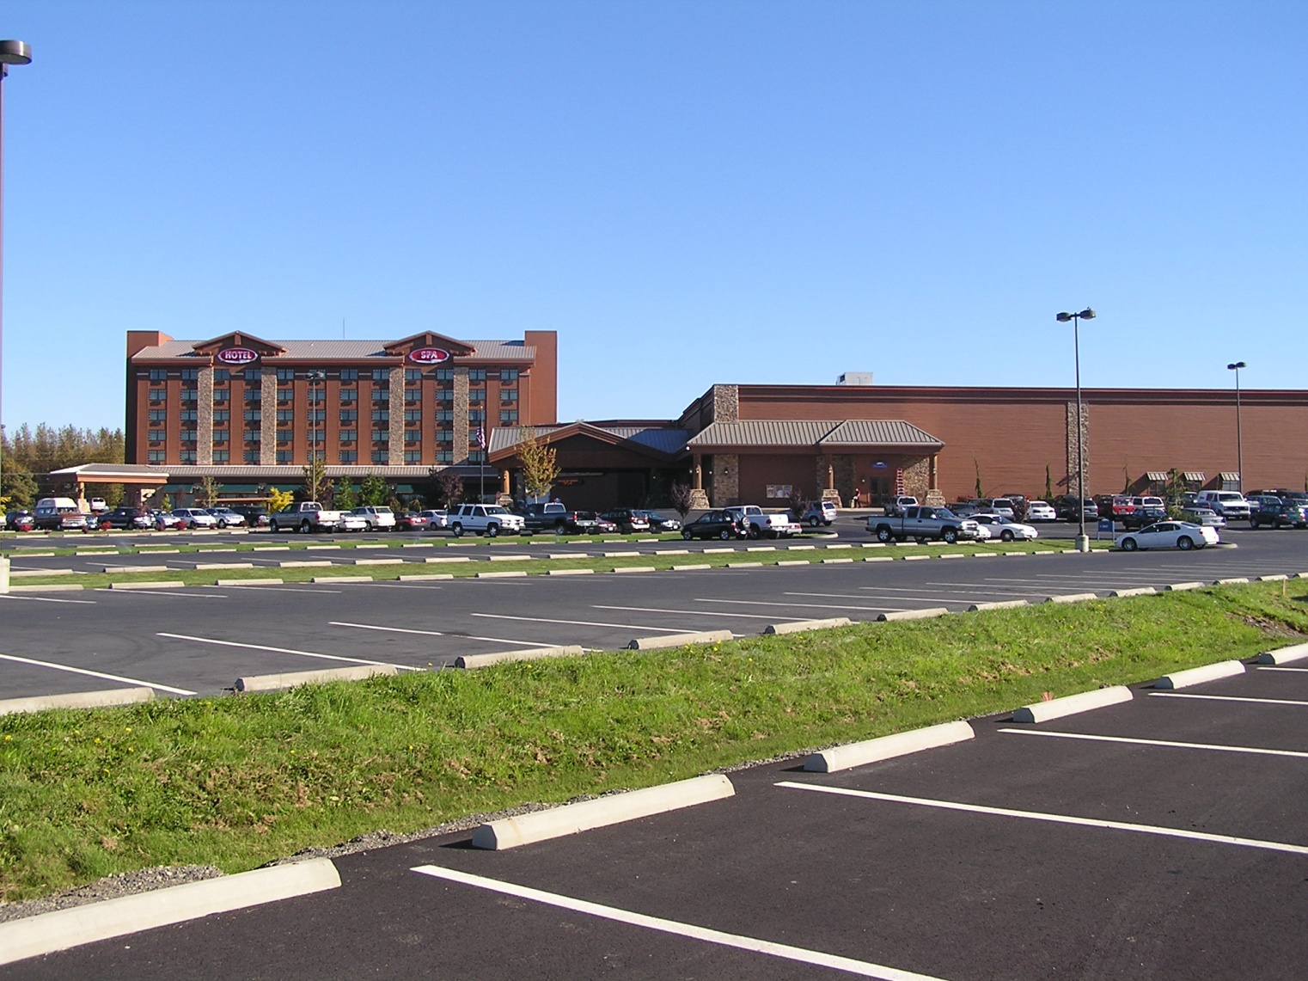
He lead the development and review of the countless projects and permits – including the Environmental Assessments for the Lummi Nation School and the Silver Reef Hotel, Casino & Spa.

Slide 14
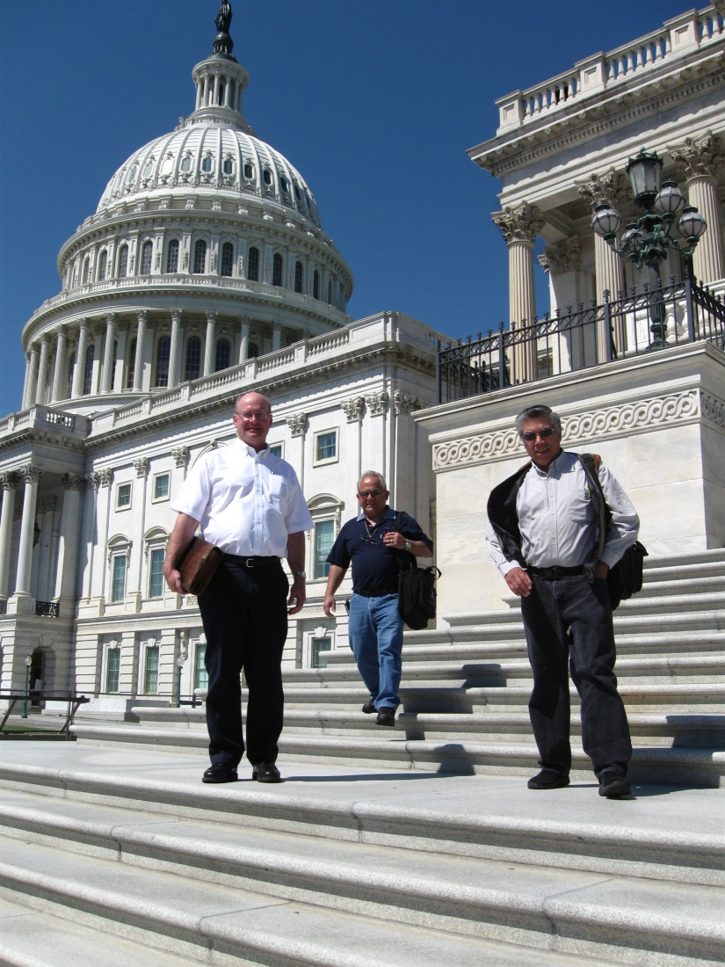
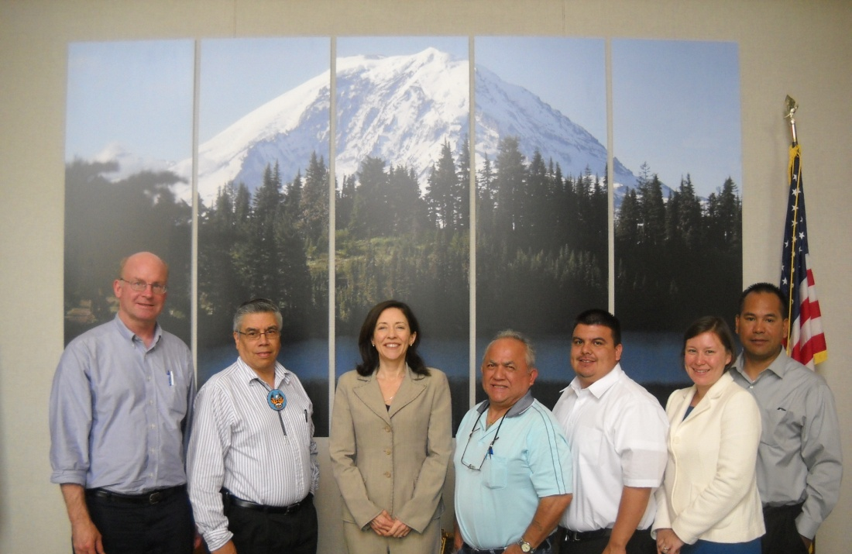
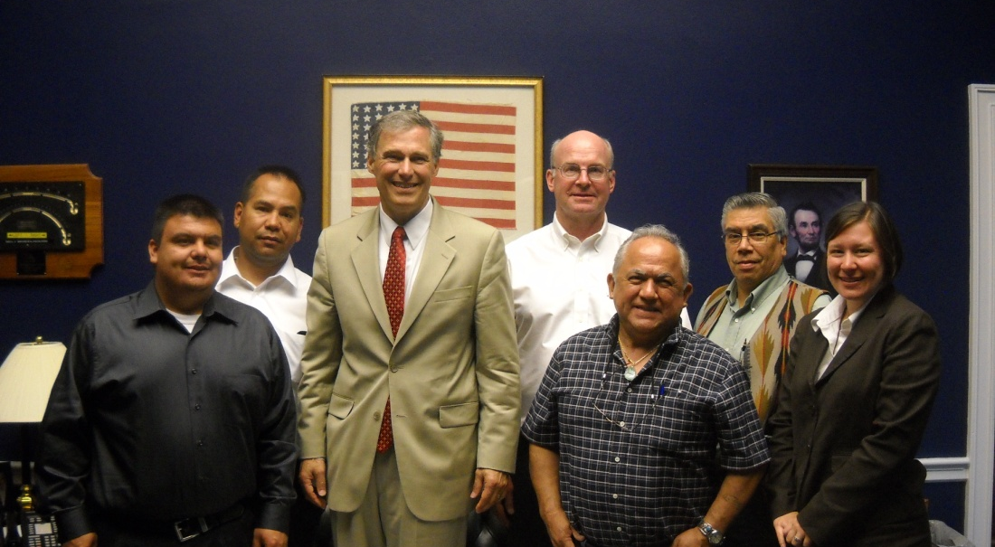
He worked tirelessly to provide technical support for the Lummi Nation's government-to-government relations with the United States.
Washington D.C. (2008)
With Senator Maria Cantwell (2011 [top])
With Representative Jay Inslee (2011 [bottom])

Slide 15
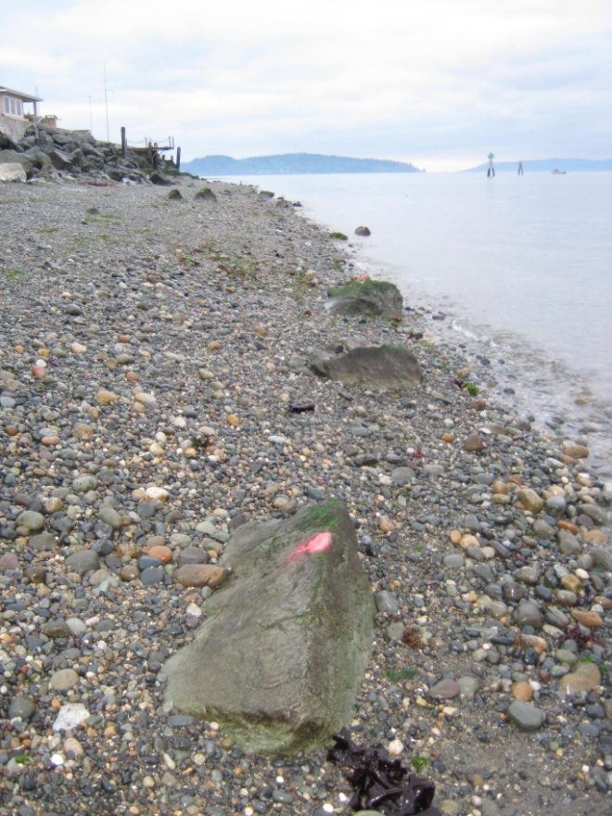
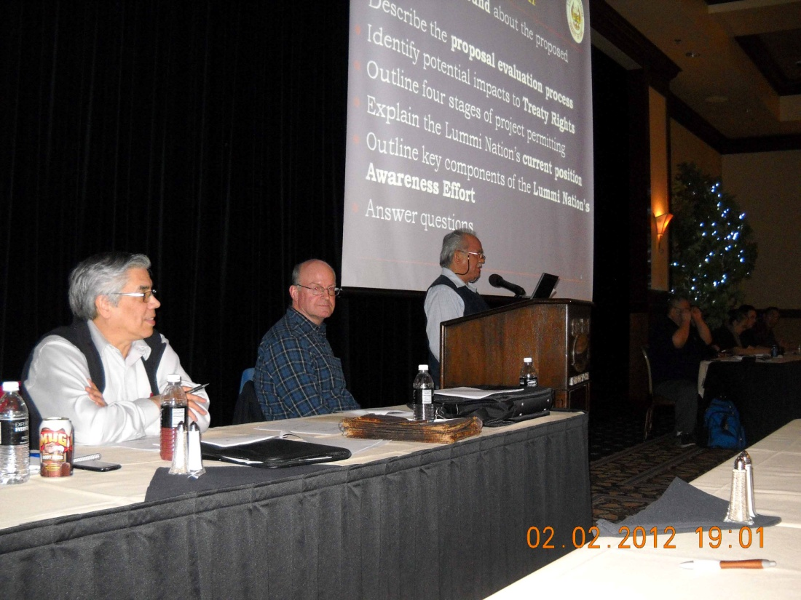
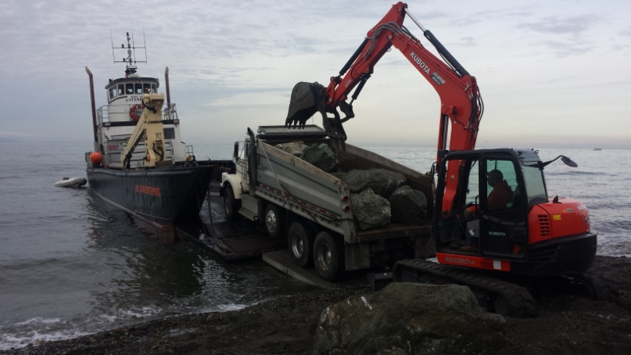
He was one of the lead technical support staff in several significant treaty rights related negotiations and/or litigation, including the Lummi Peninsula Groundwater Settlement, the Sandy Point tidelands trespass litigation, and the Shellfish Consent Decree.
General Council Meeting (2012)
Tidelands Trespass Rock Removal (2015)

Slide 16
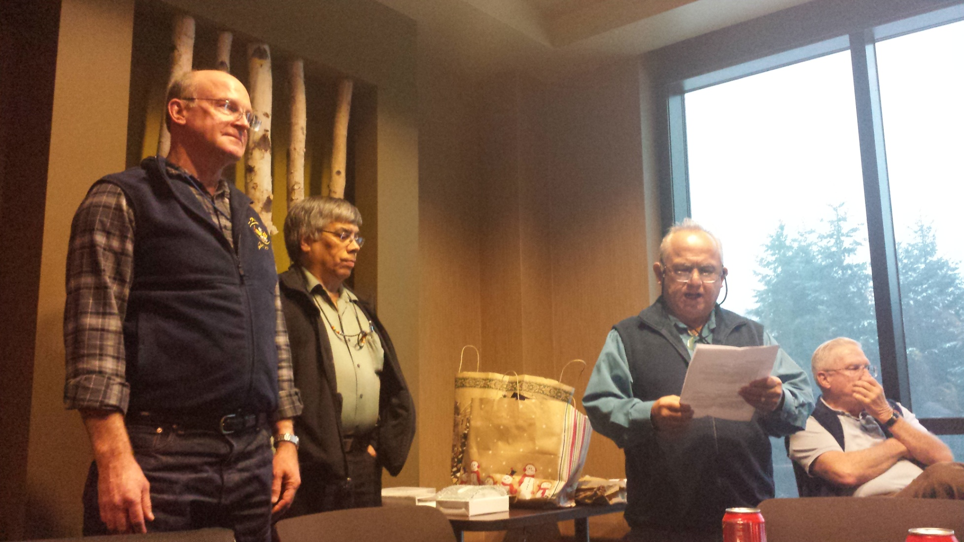
He often set the standard – and he brought out the best in those around him by holding them to high standards.
LNR Employee Awards (2013)

Slide 17
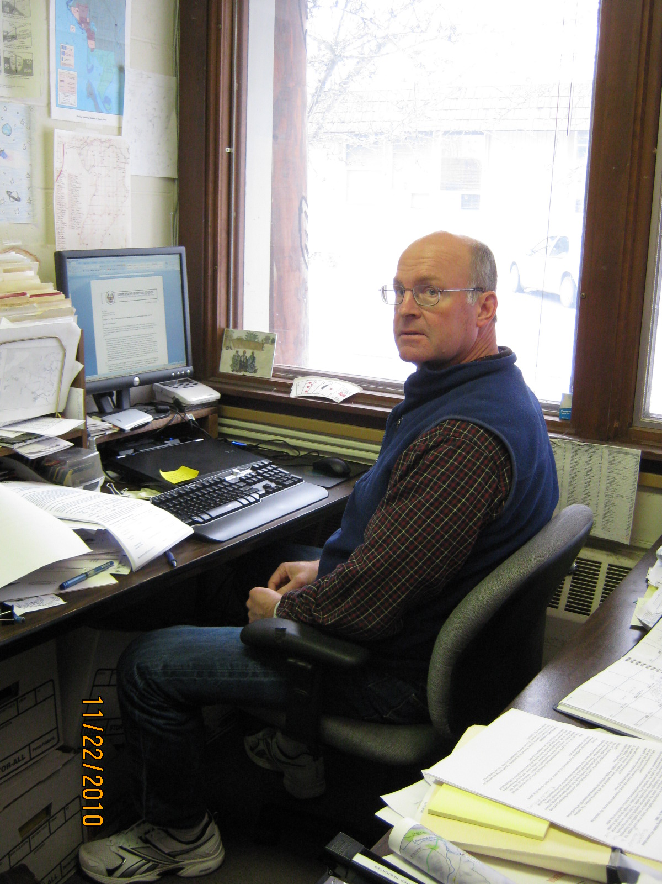
He was the consummate professional and brought a resounding level of scientific expertise and institutional knowledge to all he did at the Lummi Natural Resources Department – but he was a great leader, team member, and friend because he approached work, and life, with a level of integrity, loyalty, and kindness that we should all aspire to. He will be dearly missed.

Slide 18
Jeremy R. Freimund, P.H.
Sunrise: October 4, 1961
Sunset: May 5, 2017

